Slide 1

TDA Presentation
By Elvis Kimara

Slide 2
Problem Definition
How can we bring topological data analysis into deep neural networks and use it as a viable method for shape reconstruction.
We care because we want to extract zero dimensional features using persistent diagrams to get traits that are most prevalent
Our research question is: can this method help mitigate the problem of ghost geometries during shape reconstruction
Notes:
ensure neural networks preserve and accurately represent the underlying topological characteristics of data, crucial for applications in 3D shape analysis and point cloud processing.

Slide 3

My Role
Run multiple jobs with different losses, and networks to test our methodology

Slide 4
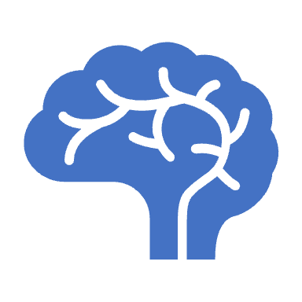
Papers Read
Implicit Geometric Regularization for Learning Shapes
Divergence guided shape implicit neural representation for unoriented point clouds
Topology-controllable Implicit Surface Reconstruction Based on Persistent Homology
Neural Splines- Fitting 3D Surfaces With Infinitely-Wide Neural Networks

Slide 5

Methodology
Use TDA losses like: combo_1_wasserstein
combo_2_wasserstein
combo_1_2
combo_1_2_wasserstein
wasserstein
And enforce TDA in MLP.

Slide 6

Loss Functions:
Combo_1_Wasserstein:
Combines a specific topological feature capture method ("combo_1") with the Wasserstein distance to align learned representations closely with original data's topology.
Combo_2_Wasserstein:
Similar to Combo_1_Wasserstein but uses a different set of topological features ("combo_2") for a more diverse representation, also minimized with the Wasserstein distance.
Combo_1_2:
Merges two topological feature capture methods ("combo_1" and "combo_2") for a broad and rich topological representation, focusing on diversity without directly using the Wasserstein distance.
Combo_1_2_Wasserstein:
A comprehensive approach that combines both "combo_1" and "combo_2" with the Wasserstein distance, aiming for a topologically accurate and diverse representation that closely matches the original data.
Wasserstein:
Focuses solely on minimizing the Wasserstein distance between persistence diagrams of the original and learned data, emphasizing topological similarity and feature persistence.

Slide 7
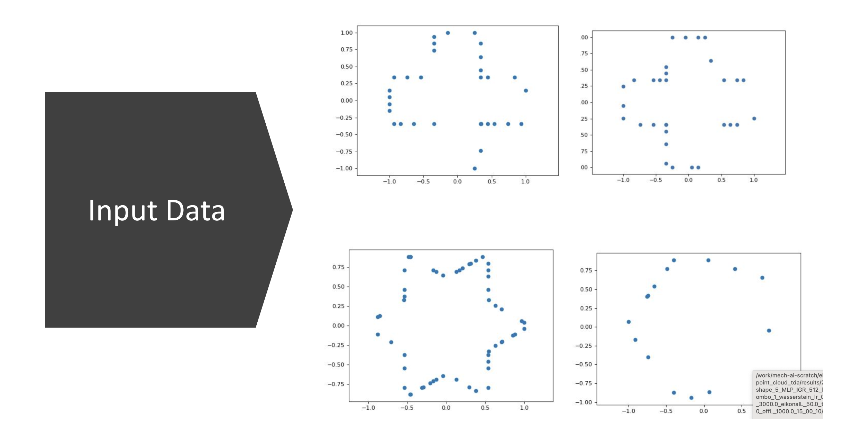

Slide 8
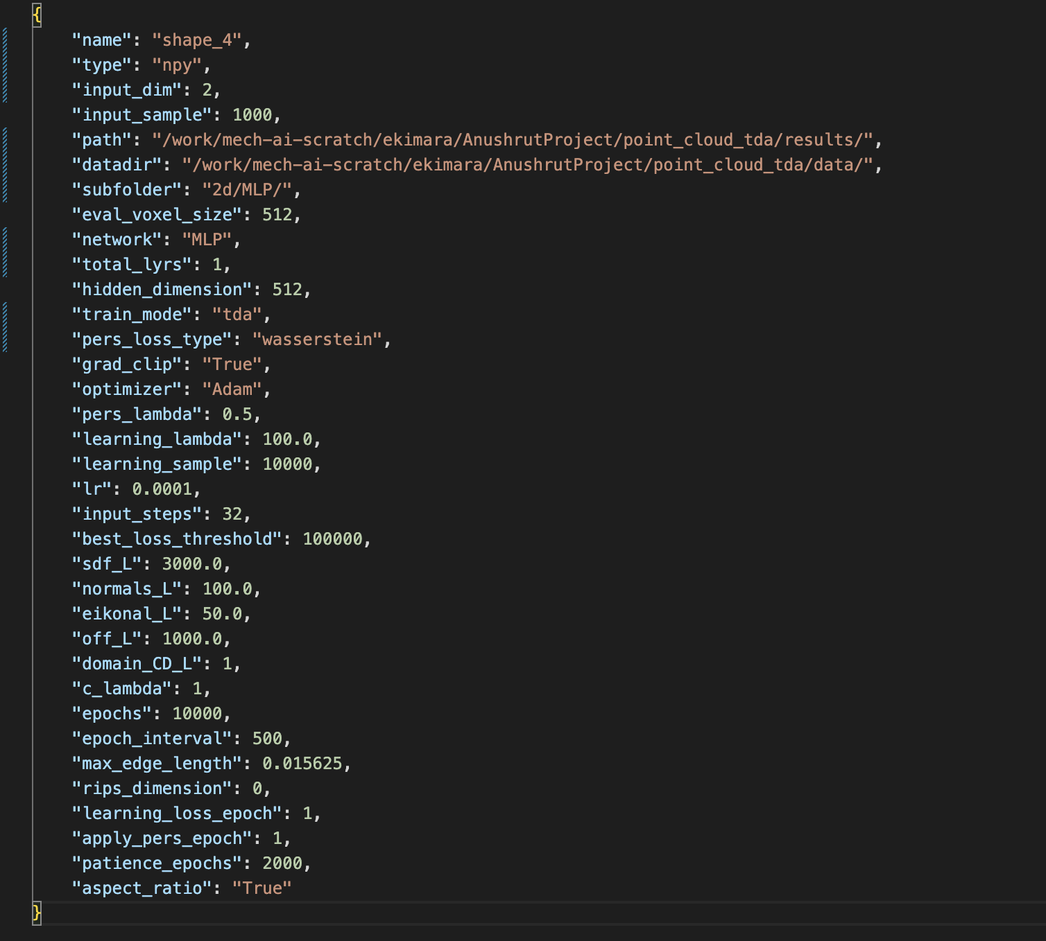
Scripts

Slide 9
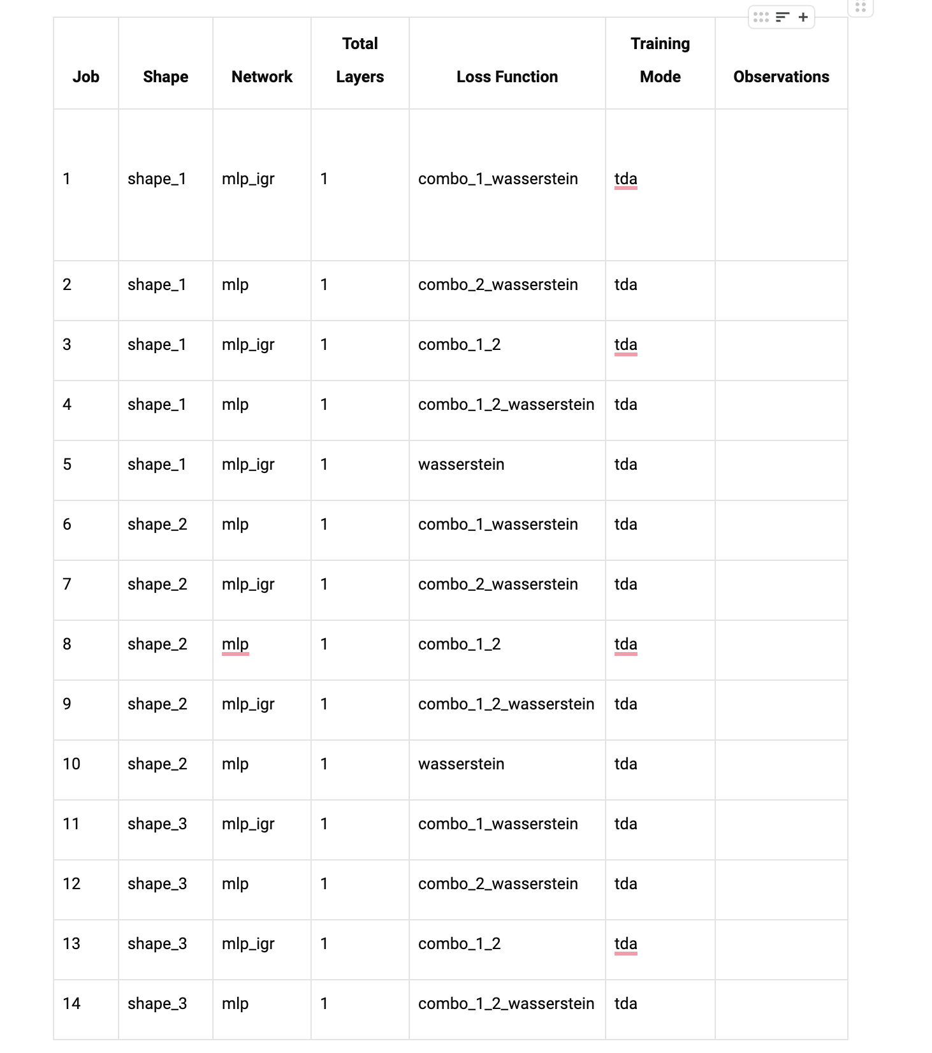
Jobs to Run

Slide 10
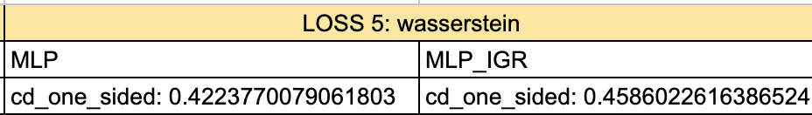
Loss comparisons

Slide 11
Next steps
Meet Anushrut later today to discuss what jobs to run next. More complex shapes, layers, ask questions, and set week goals.

